Slide 1
Welcome!
Lesson 1.1
Notes:
Simple welcome
Start at 6:35

Slide 2
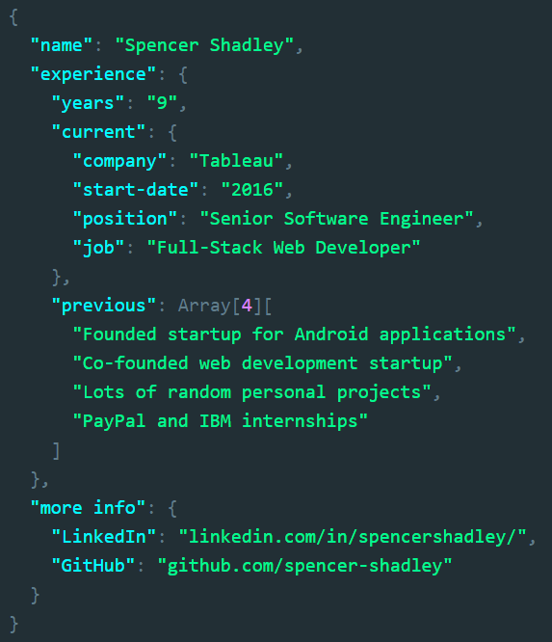
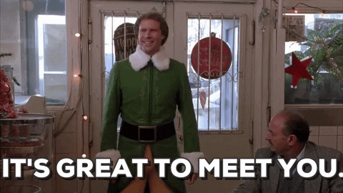
Who Am I? [Experience]
Notes:
7:05 – 7:06 (1 min)
Just read the JSON

Slide 3
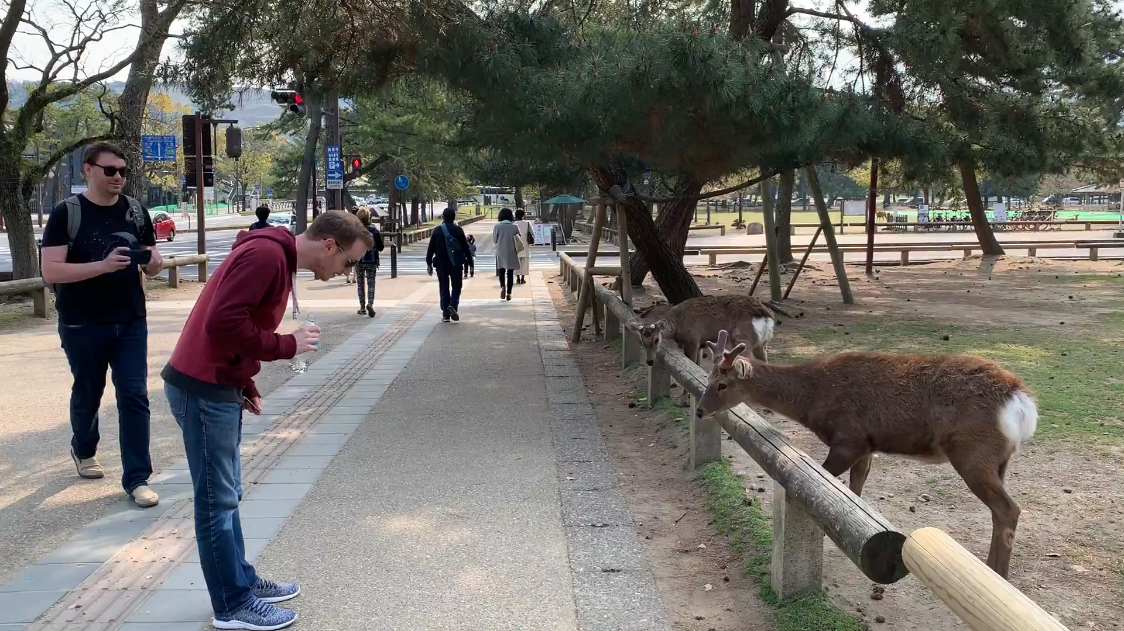


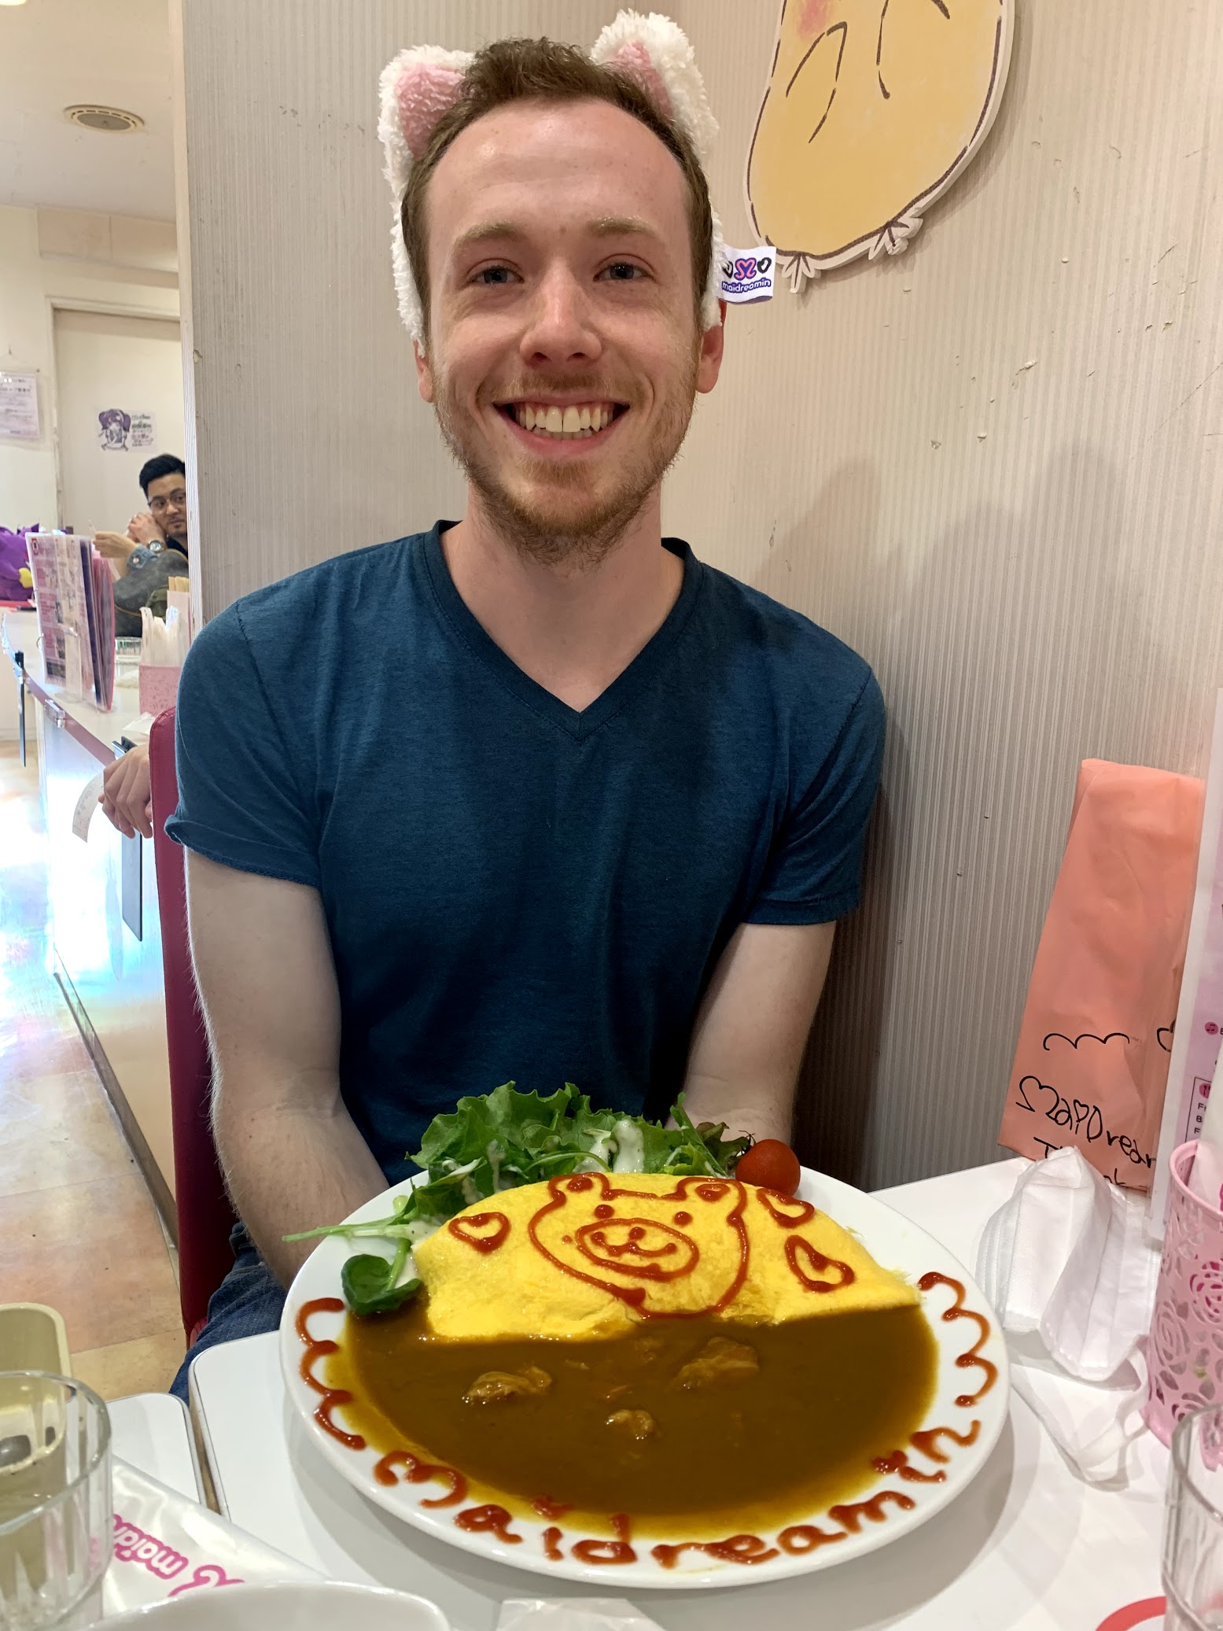

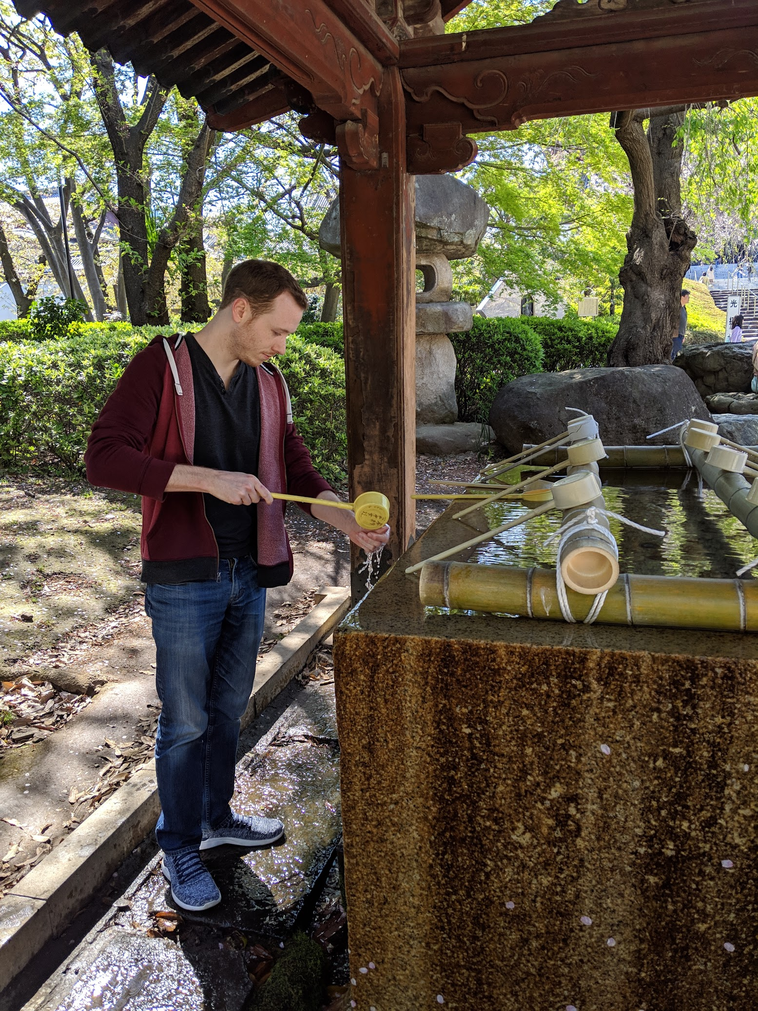
Who Am I? [Fun Fact]
Notes:
7:06-7:07 (1 min)
Japan is awesome
I love anime

Slide 4










Who Am I? [How I got into software]
Notes:
7:07-7:12 (5 min)
Go through each thing
Click Tableau
http://clipart-library.com/clipart/1203829.htm

Slide 5
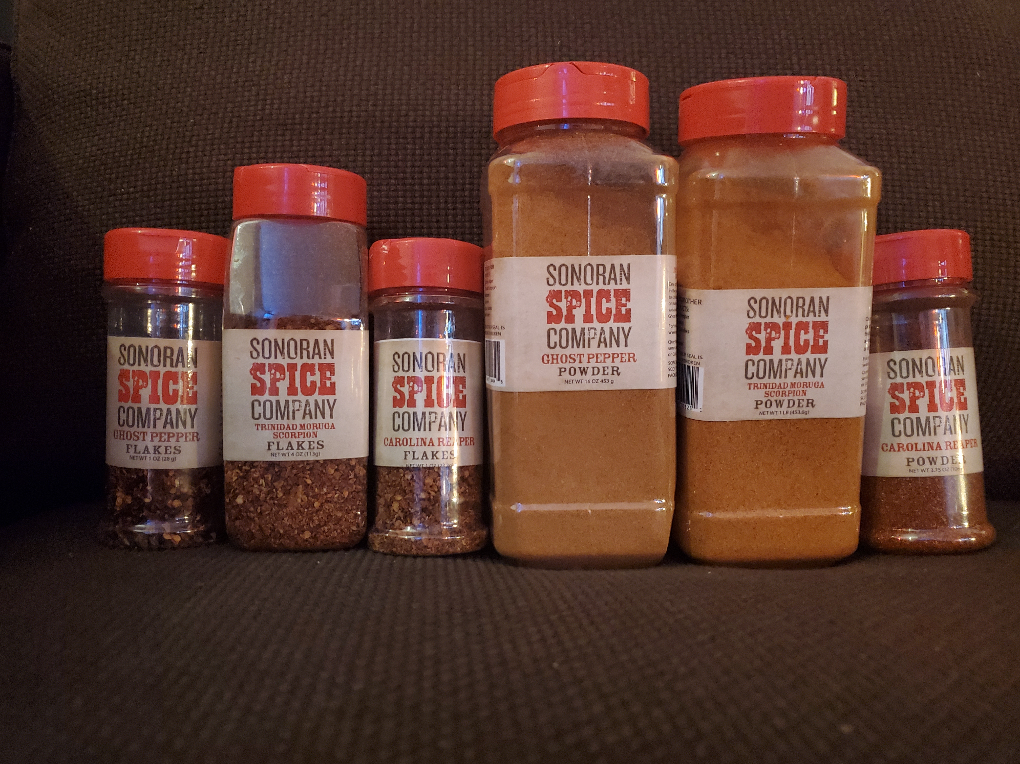
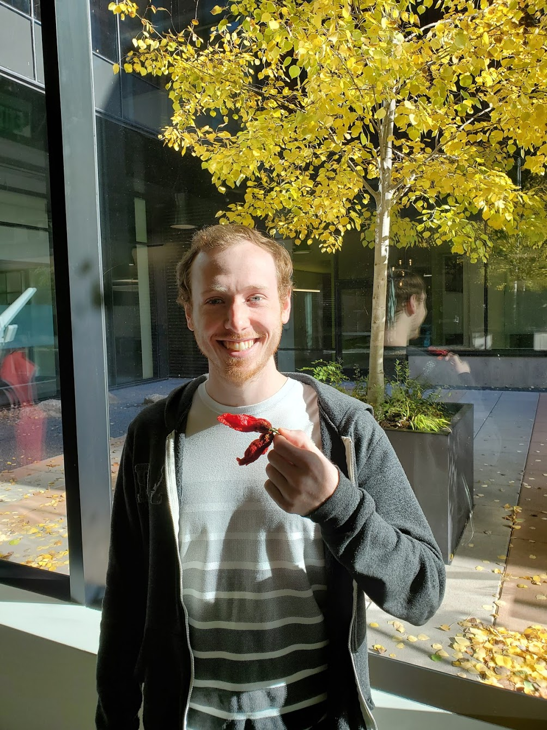
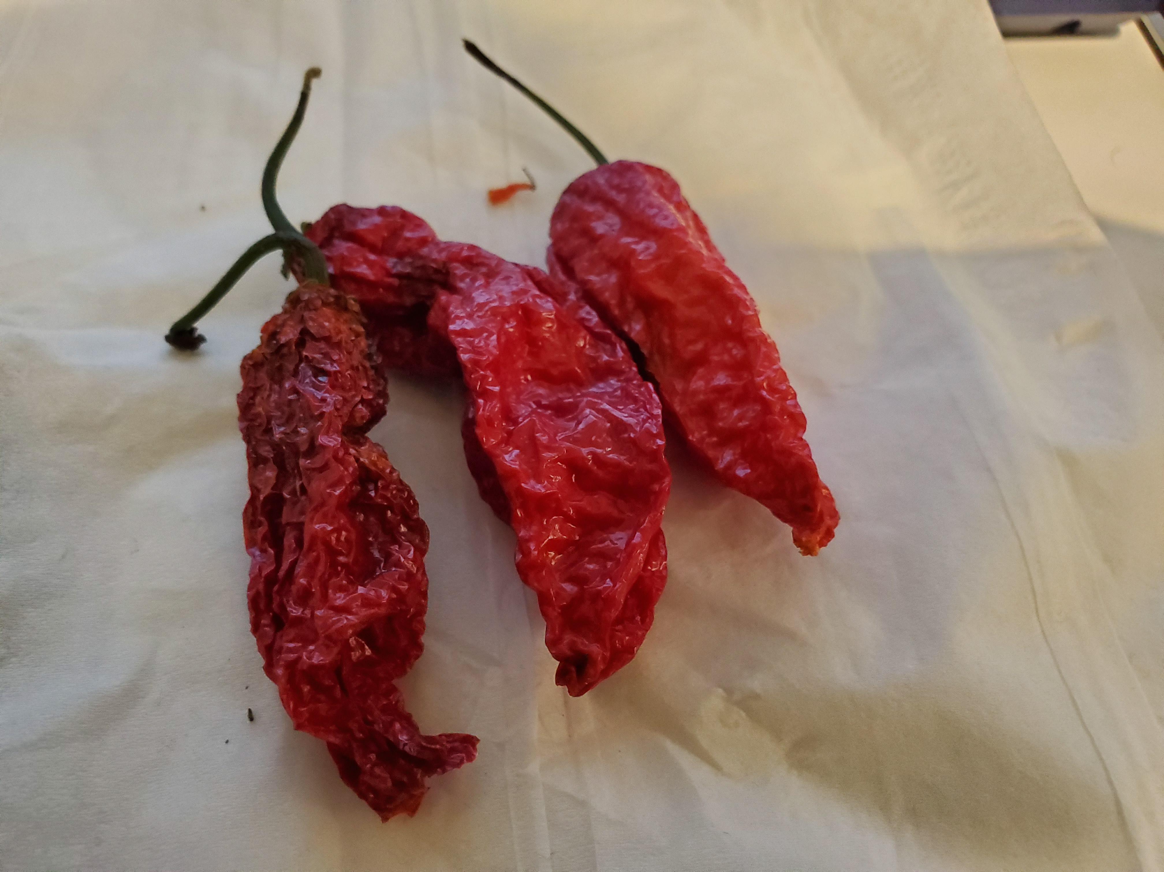
Who Am I?
Notes:
Spicy food eater
Already in other slides

Slide 6
Who are you?
Fold your piece of paper hamburger style
Fold your piece of paper a second time in the same direction
Write your name on the “tent” paper
(optional) Draw a picture that represents you
Set it up so that everyone can see it
Note: We will continue using this for the first several classes
Notes:
7:12-7:14 (2 min)
I’m bad at names and this is a large class

Slide 7
Introduce Yourself
What’s your name?
What’s your background (career, education, etc.)?
What motivated you to take this Bootcamp?
If you were the eighth dwarf, what would your name be?
Notes:
7:14-7:29 (15 min)
Each student should take about 30 seconds, just a quick elevator pitch style

Slide 8
Today’s Schedule
Today we’ll cover the following:
Introduce ourselves
Goals and how to be successful in this course
About the course
Intro to Terminal / Console / Bash
Code! Make your first webpage!
Discuss Resources and Homework
Notes:
7:29-7:31
Raise your hand if you have a question
I’ll pause occasionally to ask for questions too

Slide 9
Your Goals
And why do you want a new career?
To pursue a dream
To escape a dead-end job
To be able to create
To follow a fascination
To attain financial stability
To obtain financial freedom
To challenge yourself
To be a role model to kids
Notes:
7:31-7:33 (2 min)
We heard some of your reasons in the intro, here is a list of additional reasons you might have taken this course
All of these are valid reasons to be here

Slide 10
Our Goal = Enable Your Goals This is why we’re here. We want to help you achieve your goals.
We =
Instructor, TAs, Student Success Manager, Career Coaches, etc.
Notes:
7:33-7:34 (1 min)

Slide 11
There’s a lot of stuff in web development
You are going to learn >80 technologies
Notes:
7:34-7:36 (2 min)
This will be a lot of work
Most people do this over four years full-time plus internships
We have six months
It’s called bootcamp for a reason
At the end you’re going to be empowered to develop awesome web applications
Office hours, Slack, email, I’ll make extra time if you need it

Slide 12
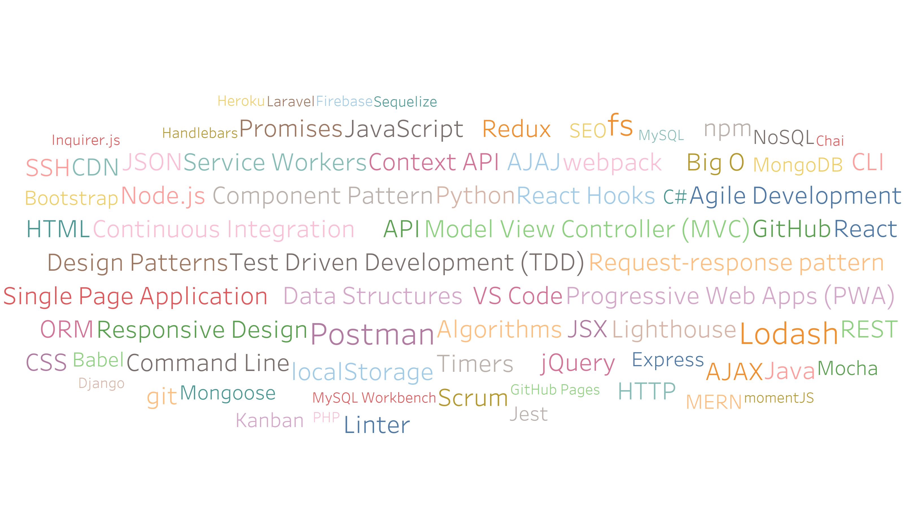
So many technologies!
Notes:
7:36-7:37 (1 min)
Ton of stuff
All of this is employer relevant
Not only will you know what all of this is by the end of the course
You will have experience building real web applications using everything here

Slide 13
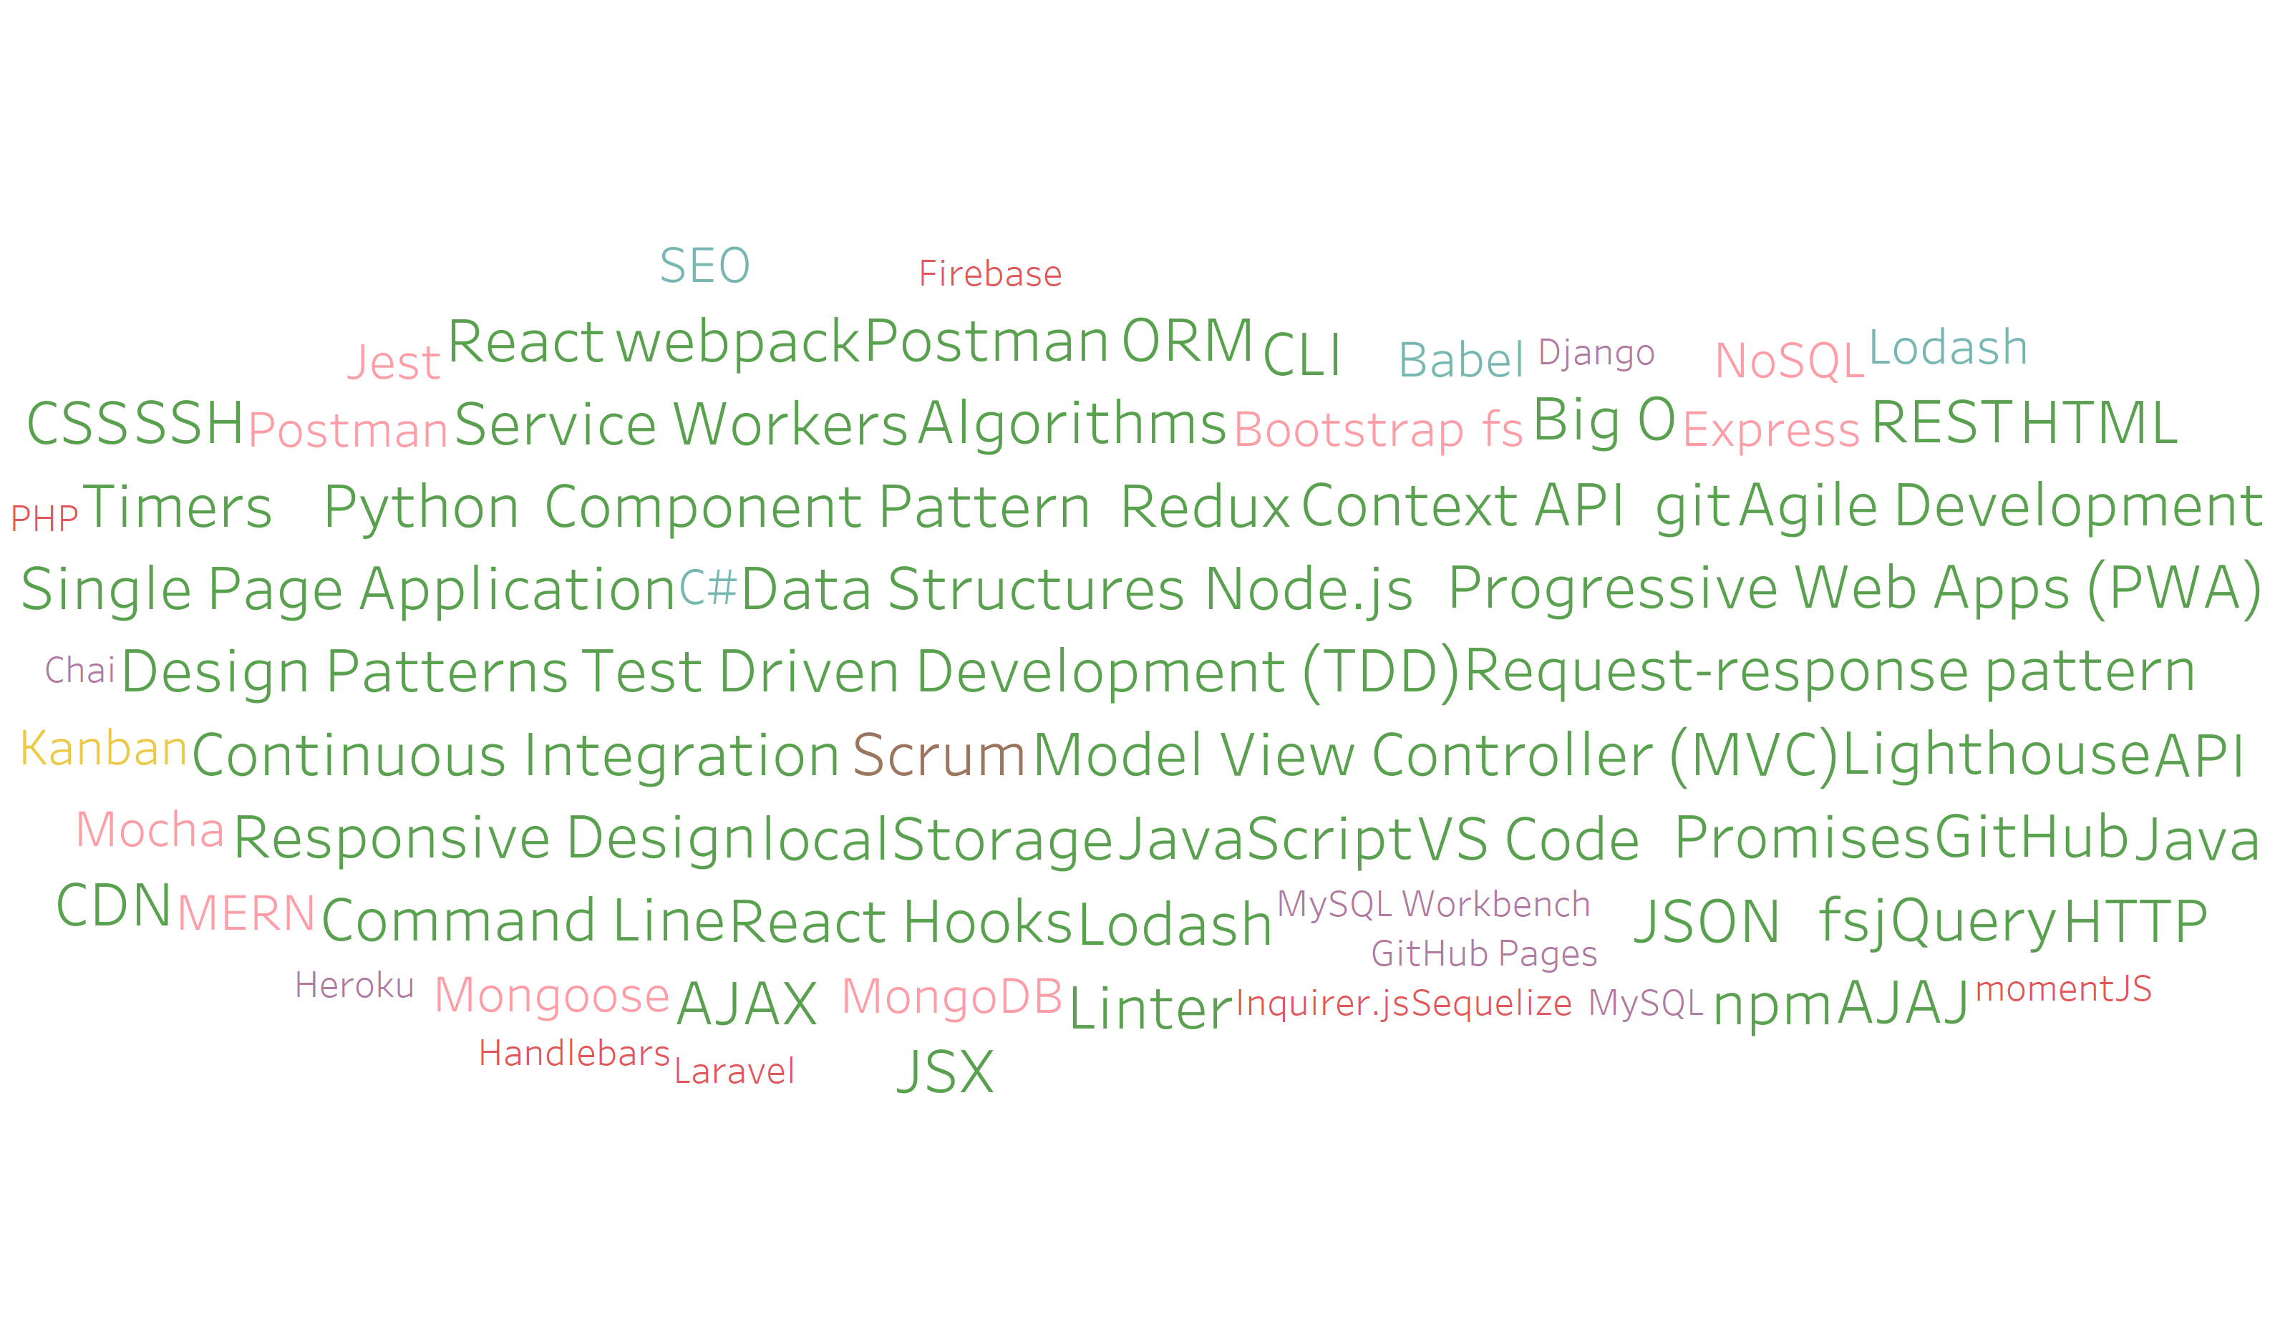
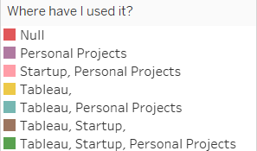
So many technologies!
Notes:
7:37-7:38 (1 min)
92.1% used by Tableau or startups

Slide 14
The Path of Learning
Notes:
7:38-7:39 (1 min)
Any questions before moving on to the path of learning?

Slide 15
You can’t learn what you think you already know
“It is impossible for a man to learn what he thinks he already knows.” - Epictetus, Discourses, Book II, ch. 17
Notes:
7:39-7:40 (1 min)
Those that have the hardest time in the program are not the ones who came in knowing no programming.
It’s not the ones who haven’t played around with HTML, CSS, or JavaScript.
It’s the ones who walk in thinking they either A) Know more than they do. Or B) Are experts in a completely different field.
There is something that stops people like this from accepting the reality.
It will only take a few weeks before everyone is leveled out.

Slide 16
Nothing comes easy.
As students, you face three
HUGE obstacles.
Notes:
7:40-7:41 (1 min)

Slide 17

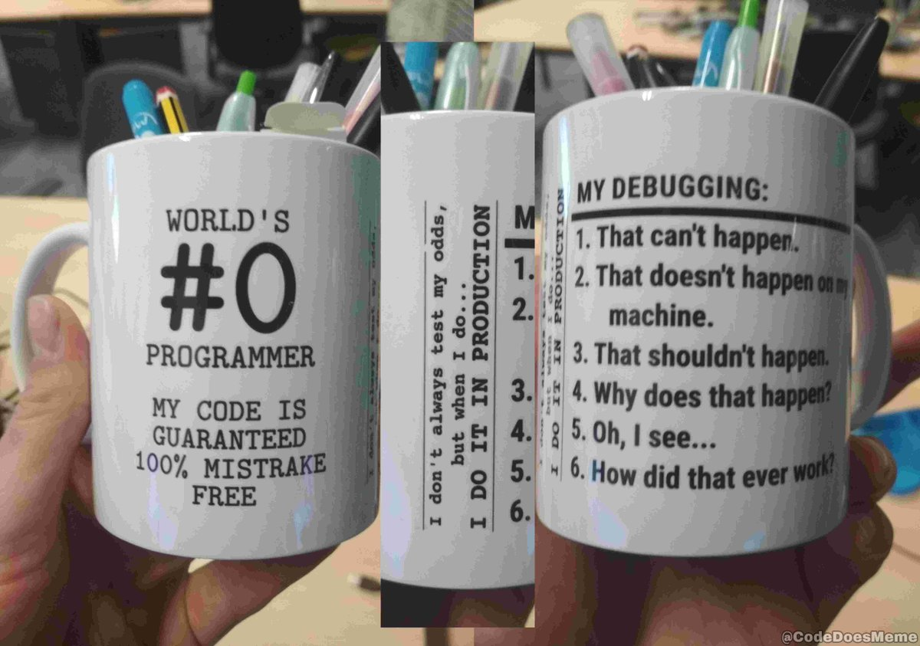
Obstacle #1: The Great Confusion
10 states of a programmer
1: My code doesn't work and I don't know why.
10: My code works and I don't know why.
Notes:
7:41-7:43 (2 min)
For those who aren’t familiar with binary “10” is 2
When programming it takes 100 times before you get it right.
Those 99 times are frustrating but that 100th time is incredibly rewarding.
shutterstock_1188695488

Slide 18

Obstacle #2: The Great Doubt
“Maybe I’m just dumb.”
Notes:
7:43-7:46 (3 min)
There will be many moments where you will doubt yourself.
Everyone is on the same page as you. No-one in this classroom is dumb. You all have varying backgrounds with differing experiences and exposure.
Everyone was where you are at some point in their career. Every developer had to build up their skills to become a successful software engineer.
In my first computer science class I didn’t know what Windows Explorer was, what a file was or how to open a file.
It was embarrassing and made me doubt my ability to succeed in that class. I sheepishly had to ask the teacher how to do each of those things and what they all were. After asking that one time I didn’t have to ask again and I grew little by little by asking these questions.
“He who asks a question is a fool for five minutes; he who does not ask a question remains a fool forever” –Chinese Proverb
It takes time but you have what it takes; you chose to take this program because you know you have what it takes. You were selected because we know you have what it takes.
The first few weeks will be difficult, but everyone will be on a pretty level playing field a few weeks in.
Ask: Who is familiar with Imposter Syndrome?
Imposter Syndrome is when someone feels they aren’t capable of the task they are given. That they are going to be found out for being a fraud. It’s a huge thing in the software industry.
It’s cyclic. Biggest thing to overcome it is recognizing that it’s just imposter syndrome – you are capable. If you feel doubt, come to talk to myself, Jen, a TA or a student you might feel comfortable with.
Perhaps tied with having self-confidence (talk about imposter syndrome - https://en.wikipedia.org/wiki/Impostor_syndrome).
“If the individual responded to the task with over-preparation, the successful outcome will be seen as a result of hard work. If the individual responds by procrastination, they will view the outcome as a matter of luck. In the impostor cycle, gaining success through hard work or luck is not interpreted as a matter of true, personal ability.”
shutterstock_215771662

Slide 19

Obstacle #3: The Great Distance
If you want to go fast, go alone.
If you want to go far, go together.
-African Proverb
Notes:
7:46-7:48 (2 min)
Obstacle 3 – you have a ton of ground to cover!
There’s a lot to learn and it can be intimidating. But honestly, 6 months will be over before you know it.
Because of the length of the program, personal issues WILL come up during the course of the program, and it will be challenging to stay motivated.
Show quote
We’re all here to help each other. Students too. We’re going to persevere together.
Persisting in general is the hardest thing in this course.
Shutterstock_411452953

Slide 20

Learning Can Be Frustrating
You can’t tell whether you’re learning something when you’re learning it—in fact, learning feels a lot more like frustration.
What I’ve learned is that during this period of frustration is actually when people improve the most, and their improvements are usually obvious to an outsider. If you feel frustrated while trying to understand new concepts, try to remember that it might not feel like it, but you’re probably rapidly expanding your knowledge.
—Jeff Dickey, author of Write Modern Web Apps with the MEAN Stack: Mongo, Express, AngularJS, and Node.JS (Peachpit Press, 2014)
Notes:
7:48-7:51 (3 min)
You will be frustrated in this course. It’s important to keep in mind that learning can feel like frustration.
If you persevere through the frustration when you look back you should be able to see that you grew and learned
Scott story:
Worked on a bug with another developer.
The issue was crazy – expanded across our C#, Java, legacy C++, ancient JavaScript and TypeScript code.
We spent ~80 hours fixing it. (X2 because two developers)
When we finally found the issue and fixed it, we wrote 3 lines of code (~27 hours per line)
It was frustrating the entire time and felt like we were wasting our time.
Coming out of it I now understand significantly more about our C#, Java, C++, JavaScript and TypeScript code as well as how our oauth connections work.
Now I’m seen as an “expert” in this area and am able to help people regularly in this same area and have been able to quickly write features around this area of the code.

Slide 21

Celebrate your success
Notes:
7:51-7:52 (1 min)
It's important to recognize your successes and to stop and celebrate them.
When we fixed that bug, that other developer and I went out to a bar and drank a lot :)
This is one way to break imposter syndrome.
https://gfycat.com/optimalelaboratehoneybee

Slide 22

Google Fu: The Most Important Skill of All
What Is Google Fu?
Notes:
7:52-7:53 (1 min)
The most important skill.
It’s just googling. Or whatever search engine you prefer.
It might sound silly but this is the most important tool a developer has.
When you don’t know how to do something it’s likely that the Internet knows.
You actually do get better at googling things as you learn the right terminology to ask and which sites are most relevant.
shutterstock_653127499

Slide 23
Course Structure
Notes:
7:53-7:54 (1 min)
Any questions before we move on to the course structure?

Slide 24
Course Overview
Week 01 - HTML-Git-CSS
Week 02 - CSS-Bootstrap
Week 03 - JavaScript
Week 04 - Web-APIs
Week 05 - Third-Party-APIs
Week 06 - Server-Side-APIs
Week 07 - Project-1
Week 08 - Project-1-Continued
Week 09 - NodeJS
Week 10 - OOP
Week 11 - express
Week 12 - MySQL
Week 13 - MVC
Week 14 - Full-Stack
Week 15 - Project-2
Week 16 - Project-2-Contd
Week 17 - NoSQL
Week 18 - PWA
Week 19 - React
Week 20 - State
Week 21 - MERN
Week 22 - Computer-Science
Week 23 - Project-3
Week 24 - Project-3-Continued
Notes:
7:54-7:55 (1 min)
24 weeks
Each week builds on the previous

Slide 25
Projects
There are three projects
They will be group projects
This is a place to showcase your new skills (and looks great on a resume!)
More details to come once they are closer
Notes:
7:55-7:56 (1 min)

Slide 26
Weekly Schedule
Class is on Tuesday, Thursday and Saturday
Office hours are 45 minutes before class and 30 minutes after class
The day before class any relevant slidedecks and unsolved activities are pushed to GitLab
After each activity a solved example activity will be pushed to GitLab
On Tuesdays a unit overview, the weekly HW and an example solution for the previous HW will be pushed to GitLab
On Tuesdays a weekly Switchboard will be due
Saturday at 11:59PM the weekly homework is due
Notes:
7:56-7:57 (1 min)
Office hours will generally be open-forum, the TAs and I will be there for any questions you have
Sometimes office hours may be structured if there is something relevant to talk about there

Slide 27
Daily Schedule
In each class, we’ll cover the following:
Set objectives
Brief background lecture
Watch me/coding demos
Code discussions
In-class exercises
Project work
Notes:
7:57-7:58 (1 min)
The first few weeks are much more presentation heavy. It will become more focused on code as we go.
Each lecture will be live on Panopto if you need remote access. Link will be posted in #remote channel
Questions?

Slide 28
The House Cup
Notes:
7:58-8:00 (2 min)
Mention we will be keeping track of the house cup
Let a TA know when you did something you believe should earn points

Slide 29
Prework
Notes:
8:00-8:01 (1 min)
You should have received a link to the prework (Slack and email.)
We’re going to spend some time checking that everyone has everything installed from the pre-work and go around the room helping people who are having trouble.
If you got everything installed, spend this time helping your neighbors. This should be your habit – try asking for help from your neighbors before going to a TA.
Let’s go through what you should have installed.

Slide 30
Accounts Checklist
You should have accounts for:
GitHub (with SSH Integration)
Heroku
LinkedIn
Stack Overflow
GitLab
Notes:
8:01-8:02 (1 min)
GitLab
https://uwa.bootcampcontent.com/UWA-Bootcamp/UW-SEA-FSF-PT-11-2019-U-C
If you haven’t setup these accounts please do so, by the end of today you need to make sure you have access to at least our GitLab repo.

Slide 31
Software Checklist
You should have all of these installed (we will use the bold things today):
Slack
Google Chrome
Visual Studio Code
Git Bash (Windows) or Terminal (pre-installed on Mac)
Git (ssh -T git@github.com should print your username) (help link)
Node.js (node should open a new UI where you can try 1+1)
Heroku-CLI (heroku should print some help commands)
Notes:
8:02-8:30 (28 min)
Help installing
https://coding-bootcamp-fsf-prework.readthedocs-hosted.com/en/latest/modules/chapter2/
Slack
Open Slack
Primary way to communicate
Please include an actual picture of yourself as your avatar
Chrome
You can use your favorite browser out of class, we will test with and develop against chrome in class because Chrome has the best development tools
Visual Studio code
This is where we will write code
It's a very nice text editor with autocomplete, syntax highlighting and support for extra extensions
Git Bash
Windows only
Terminal
Mac only
Pre-installed
Show
echo “hello”
Node.js
node
1+1
ctrl+C
git
git
ssh -T git@github.com
Heroku-CLI
heroku

Slide 32
The Modern Web
Notes:
8:30-8:45 (15 min)
15 minute break

Slide 33
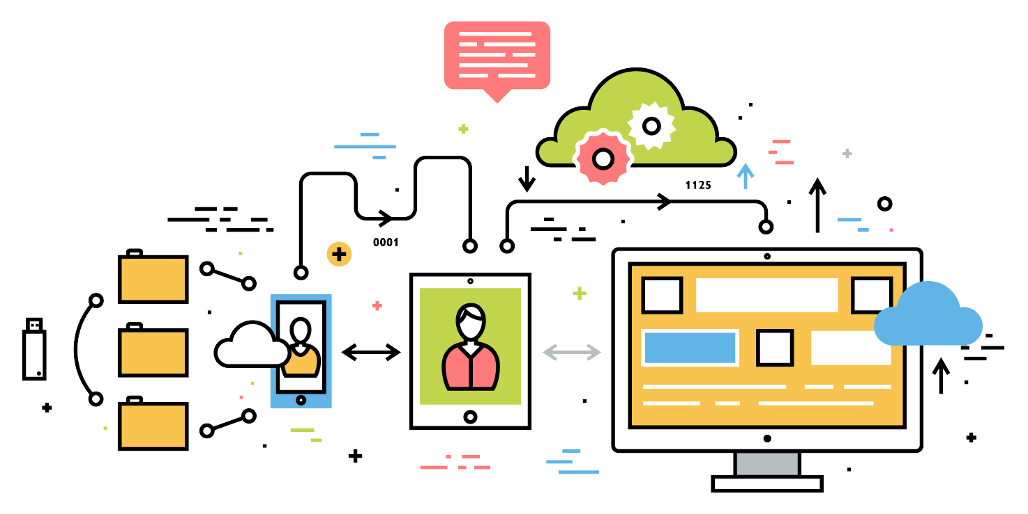
What Exactly Is Full-Stack Development?
Notes:
8:45-8:47 (2 min)
Ask students: So what do you think it means to be a “full stack developer?”

Slide 34
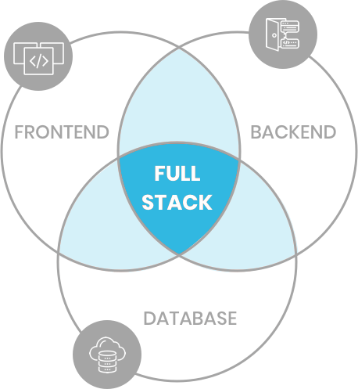
Full-Stack Development
Full-stack development is writing code which supports an entire web application
Front-end development to visually display an application to the user. Understands how to display data.
Back-end development, the core logic of the system. Chooses which data to display.
Database for long-term (non-volatile) storage. This is used by the back-end. Sometimes this is considered part of the back-end.
Notes:
8:47-8:49 (2 min)
http://www.teclogiq.com/images/fullstack-development.png

Slide 35

The “Magic” of YouTube
Notes:
8:49-8:54 (5 min)
Displaying YouTube required several things to come together:
The front-end
The back-end
A database
The front-end is what you see and what you interact with. The front-end is in charge of the user interface, where and how to put things. How to handle user interaction.
The backend empowers the front-end, it tells the front-end which videos and what data to display. It has the logic for which underlying data should be used.
The database stores information – video upload date, view count, the video itself, etc.
The database stores data that could be shown,
the back-end chooses which data to show,
the front-end chooses how to show that data.
Does that make sense? Can I get a fist-to-five?
If low, ask a student for another site to try.
shutterstock_1024261021

Slide 36




Full-Stack Development
FSF FLOW
In modern web apps, there’s a constant back-and-forth communication between two key components: the visuals displayed in the user’s browser (front end) and the data and logic stored on the server (back end).
Browser shows webpage to user
Web browser
Front-end
User makes
a request
Browser talks to server
Server sends HTML back to browser
Database
Server queries database
Server
Back-end
Database returns query results
Server passes data to template engine
Template engine renders HTML
Template engine
Notes:
8:54-8:56 (2 min)
You don’t need to understand all of this just yet.
This is just an idea of how each system interacts with each other.
Websites today are all about reading code for these components – “front-end” and “back-end”

Slide 37
> Terminal
Notes:
8:56-8:57 (1 min)
Any questions before we move on to the terminal?

Slide 38
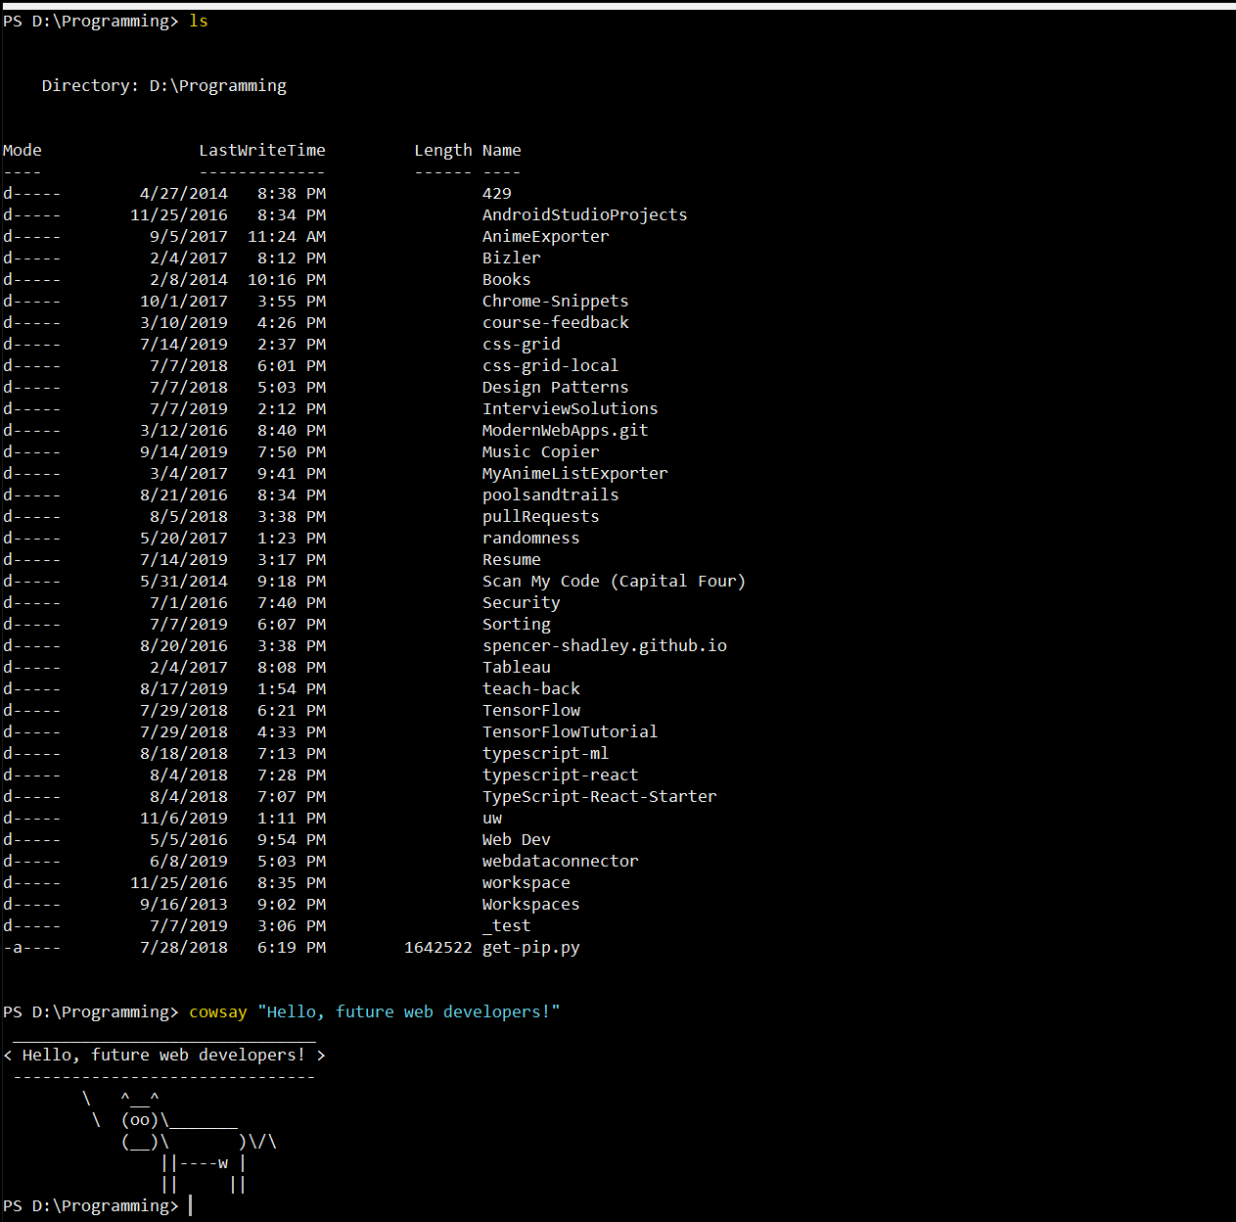
Intro to Console/Terminal
Notes:
8:57-8:59 (2 min)
What you are probably used to seeing on your computer is a GUI representation of your computer.
The terminal exposes what’s really happening and gives you full control over your computer.
You'll hear the word "directory" a lot
A folder is a way to visually represent a directory. The directory is what’s actually on your computer.
Show in Finder

Slide 39
> Intro to Console
Notes:
8:59-9:07 (8 min)
So let’s run through a couple of examples.
pwd
cd
cd ~
cd ..
ls
mkdir
rmdir
touch
rm
open file (say on windows this is explorer file)
open . (say on windows this is explorer .)
code . (if you're on mac and this didn't work, see the prework materials or talk after class)
tab auto-complete
up arrow

Slide 40

Console Command Best Practices
Always use lowercase for directory and file names
Never put spaces in directory or file names
Use dashes to separate words in directory and file names (dash-case)
Notes:
9:07-9:08 (1 min)

Slide 41
Activity: Console Commands
5 minutes
Notes:
9:08-9:08 (<1 min)
Our first activity!
We often send out an activity for everyone to work on
TAs: Slack out the activity to #01-class-activities
also, slack the command cheat sheet
We will walk around helping

Slide 42

Activity: Console Commands
Suggested Time: 5 minutes
From the terminal/console and using only the command line:
BONUS!
Create a new directory with the name first-day-stuff.
Create a new HTML file with the name first-day.html.
Open the current directory containing the new HTML file.
Create multiple directories/folders with the names one-directory and second-directory with one command.
Create multiple files with the names one.html and two.html with one command in the first-day-stuff directory.
Notes:
9:08-9:13 (5 min)
Power clap in three, two, one...
Ask the class if they found any cool new commands we didn’t cover
Did everyone get this working? Anyone want me to go through the activity?

Slide 43
Pop Quiz - Console Commands
List files and directories
Change directory
Create a new directory
Delete (remove) any directory
Create a new file
Delete (remove) a file
Open file or directory in VS Code
> ls
> cd my-cool-directory
> mkdir my-new-directory
> rmdir –r my-directory
> touch my-new-file
> rm my-file
> code file-or-directory
Notes:
Cut for time

Slide 44
Pop Quiz - Console Utilities
Alias for the current directory’s path
Alias for the parent directory’s path
Alias for your home directory
Tab auto-complete
Kill a currently running process
Up arrow
Google “Linux command for…”
> .
> ..
> ~
> cd <tab>
> ctrl+C
> Cycles through previous commands
Notes:
Cut for time

Slide 45
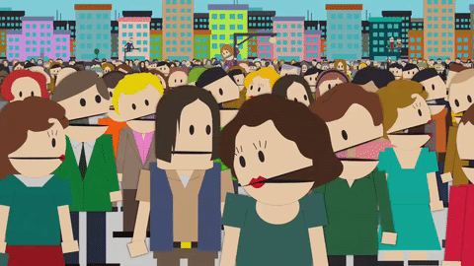
Intro to Console: Discuss with Neighbors
What is the process for creating files, removing files, etc.?
Explain what “Full Stack Development” is to one another.
Notes:
9:13-9:18 (5 min)
3 minutes to discuss
the process of creating files, removing files, etc.
what is full stack development?
Openly ask if anyone wants to share. Cold call if necessary.
https://media0.giphy.com/media/3o6ZtdLTaO5oidSO3u/source.gif

Slide 46
Hello, HTML
Notes:
9:18-9:18 (<1 min)
Now that you can create files from the terminal, let’s create an HTML file and write some HTML.

Slide 47
<html>Demo</html>
Notes:
9:18-9:23 (5 min)
Instructor Do: Do the activity for creating an html page
We're going to create a new HTML file in VS Code. Have students follow along if they can but tell them not to get too bogged down if they are having trouble keeping up. They will have a chance to work on an example of their own later.
Use the code in my-first-html.html as a guide
Create directory and HTML file in command line
code example.html
<!DOCTYPE html>
<html>
<head>
<title>
Open file in browser (talk about "Open in Default Browser")
<body>
<h1>
Refresh page
<img src="https://thumbs.gfycat.com/BlandTeemingFrillneckedlizard-small.gif" alt="Spongebob Learning"/>
<br>
<a href="https://www.reddit.com/r/ProgrammerHumor/" target="_blank">Programmer humor in a new tab!</a>
<br>
<strong><a href="https://www.youtube.com/channel/UCtxCXg-UvSnTKPOzLH4wJaQ"></a></strong>
<a href="#">This is a placeholder link, it goes nowhere...></a>
Ask if there are any questions before proceeding to the student exercise.

Slide 48
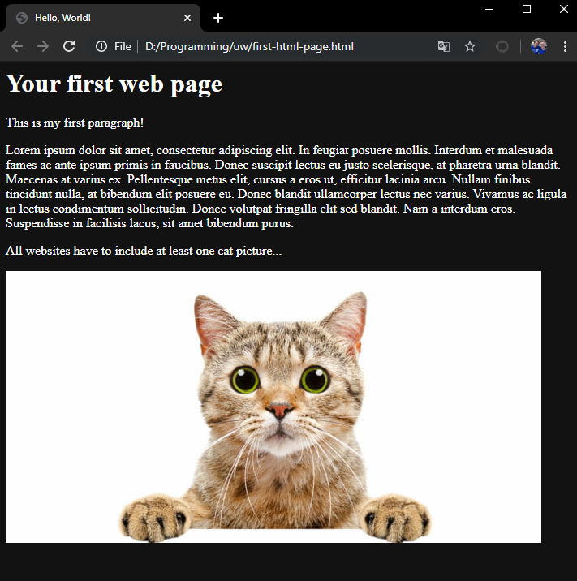
<title>Intro to HTML</title>
HTML5
HTML is one of the three base languages behind every website.
It defines all the basic content and a bit of formatting.
It is a markup language. This means there is some base information which has additional context added to it by “marking” it up.
Notes:
9:23-9:24 (1 min)
Markup history – started with people adding information in the margins and drawing on the paper
Computer can’t understand arrows and underlines – had to be standardized
Go back to demo we just did
Base text is the link text
Marked up with a to show that this should be a link
Marked up more to say and this is what it should open

Slide 49
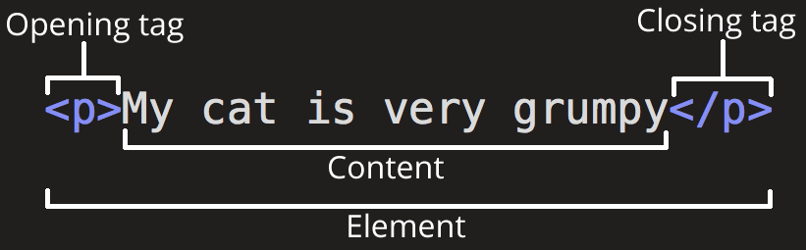
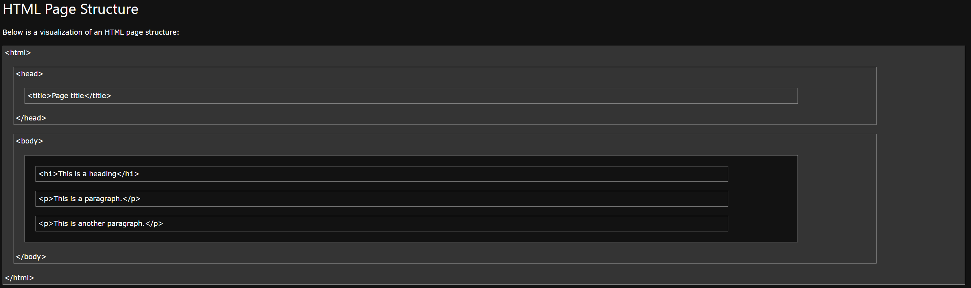
<html>Intro to HTML</html>
Parts of an element
Content: The base text
Tag: Indicates beginning and end of an element
Attribute: Additional information about an element
Element: The marked up content
Nesting Elements
HTML pages are composed of elements inside elements
To add more information we wrap items in additional tags and add attributes
Resources
https://www.google.com/ (yes, this really is the best resource)
https://www.w3schools.com/html/
https://developer.mozilla.org/en-US/docs/Web/HTML
Notes:
Removed for time
Images from :
https://developer.mozilla.org/en-US/docs/Learn/HTML/Introduction_to_HTML/Getting_started
And
https://www.w3schools.com/html/html_intro.asp

Slide 50
Activity: Intro to HTML
10 minutes
Notes:
9:24-9:24 (<1 min)

Slide 51
Activity: Intro to HTML
Suggested Time: 10 minutes
In a new HTML file, create the basic structure of an HTML document and include the following in it:
DOCTYPE declaration
Head tag with a title tag
H1 tag with a title of your choice
An embedded image
Now add the following three links to your page:
One link that has target="_blank" so that it opens a new tab when clicked
One link that is bold
One link that is only a placeholder (it goes nowhere)
BONUS!
Create an ordered list of steps to make a sandwich
Create an unordered list of five bands/musicians you like
Create a table with two columns (animal class and animal name) and four rows of animals
Use an alternate way of separating links without line breaks
Embed a YouTube video of your favorite band/musician
Notes:
9:24-9:34 (10 min) (only include if we have time)
3 minutes of remaining required material
Need to be at <9:12 to do this
TAs slack out instructions
Keep showing the code we just wrote

Slide 52
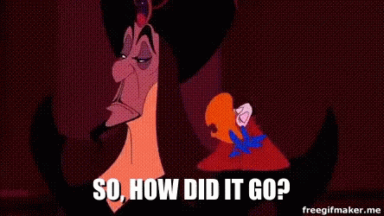
<title>Intro to HTML</title>
Notes:
9:34-9:39 (5 min)
Fist to five
Open solution and go through line by line
Talk about indentation (ctrl+j)
Allow more questions

Slide 53
Weekly Homework Assignment
Thursday 11/21
Notes:
9:39-9:41 (2 min)
Demo index.html
This will be the first homework assignment
More details will come on Thursday
It will be due on Thursday the next week

Slide 54
Mini Homework Assignment
Next Class
Notes:
9:41-9:41 (< 1 min)

Slide 55
Mini Homework Assignment
Due Date: Next Class
1
Bookmark and star the GitLab repo for our class
2
Play with some terminal commands. Try the class examples again!
3
Go through W3 Schools HTML tutorials and documentation
(HTML HOME through HTML Paragraphs)
4
Make an HTML page
(Watch the walkthrough video if you feel a bit lost.)
5
(optional) More practice: https://developer.mozilla.org/en-US/docs/Learn/HTML/Introduction_to_HTML
Notes:
9:41-9:42 (1 min)
These details are in the GitLab repo
TAs: Slack this link - https://uwa.bootcampcontent.com/UWA-Bootcamp/UW-SEA-FSF-PT-11-2019-U-C/tree/master/01-Week_HTML-CSS/01-Day_Intro-HTML#mini-homework

Slide 56
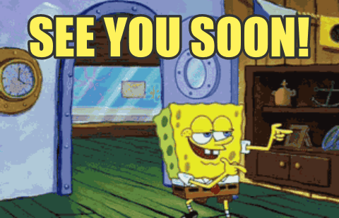
See you on Thursday!
Notes:
9:42-9:42 (<1 min)
We will be here until 10PM if anyone has questions

